Slide 1












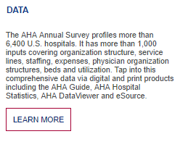


AN AMERICAN HOSPITAL ASSOCIATION COMPANY
Data Media Events Services Connect Blog About
Data
Media
Events
Services
Connect
Blog
About
Dive deep with the most trusted data in health care. Identify challenges. Find solutions. Gain insights. Make smart decisions.
Get AHA Data
How health care leaders connect with data, education, tools and networking opportunities to help them achieve performance excellence and provide exceptional care in their communities.
Kill red border-top except on hover; add box shadow

Slide 2


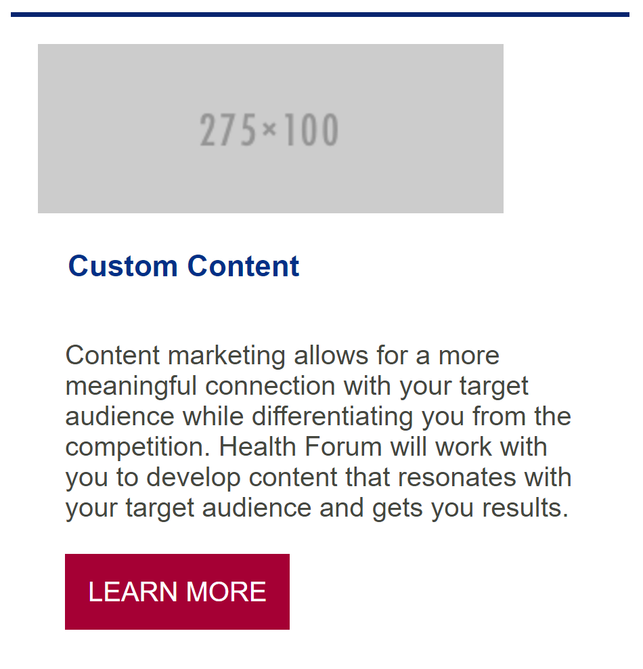
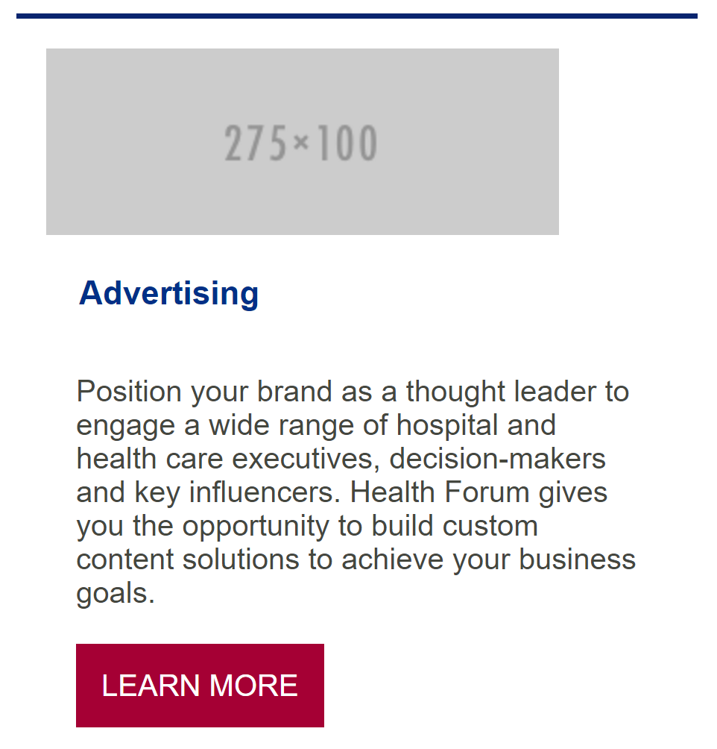
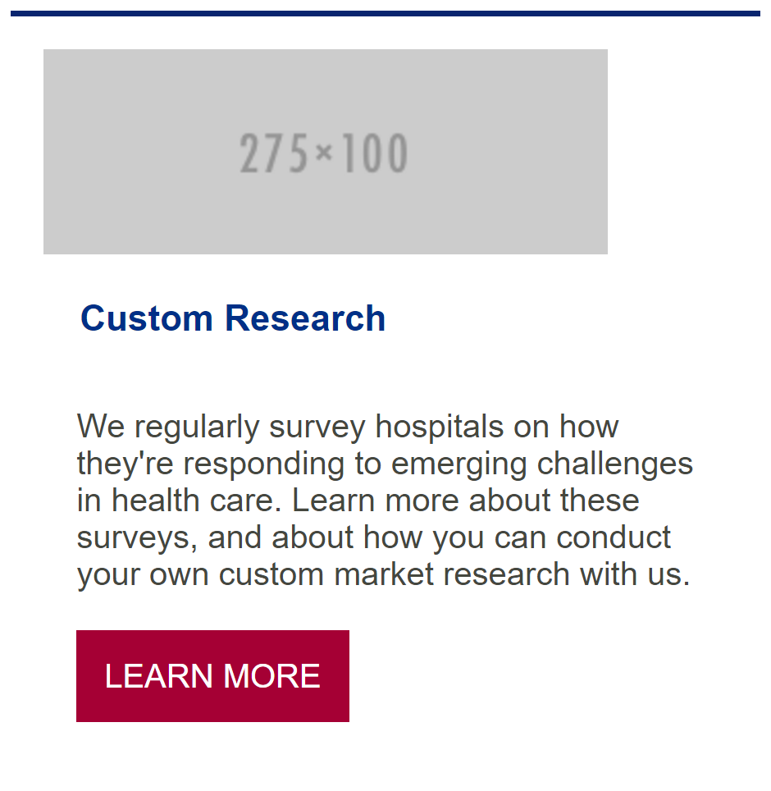









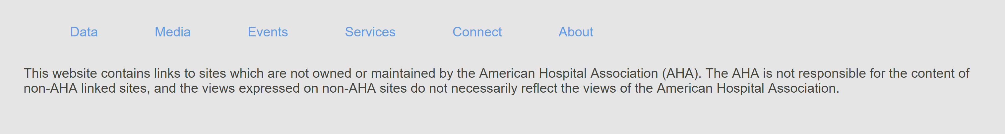
Animate with ease in?
Kill border top except on hover; change button to hollow/filled on hover; add box shadow
Put Health Forum to work for you. Contact us and one of our account executives will call you.
Popover that settles at bottom after 5s?
Get started

